Slide 1
Memory

Slide 2
Memory
Used to store binary information.
It has two Types
1. Random Access Memory (RAM)
Can perform read and write operations
2. Read-Only Memory (ROM)
Can perform only read operations.

Slide 3
RAM Types
  Static Random Access Memory (SRAM)
    Data stored so long as Vdd is applied
    6-transistors per cell
    Faster
    Differential
  Dynamic Random Access Memory (DRAM)
    Require periodic refresh
    Smaller (can be implemented with 1 or 3 transistor)
    Slower
    Single-Ended

Slide 4

Block Diagram of RAM
N-bit Data Input
(for Write)
N
K-bit address lines
Memory Unit
K
Read/Write
2^{k} words
N-bit per word
Chip Enable
Or Mem Sel
N
N-bit Data Output
(for Read)

Slide 5
Memory Description
Capacity of a memory is described as
  # addresses (words) x Word size
  Examples:
Memory | # of addr | # of data lines | # of addr lines | # of total bytes
1M x 8 | 1,048,576 | 8 | 20 | 1 MB
2M x 4 | 2,097,152 | 4 | 21 | 1 MB
1K x 4 | 1024 | 4 | 10 | 512 B
4M x 32 | 4,194,304 | 32 | 22 | 16 MB
16K x 64 | 16,384 | 64 | 14 | 128 KB

Slide 6
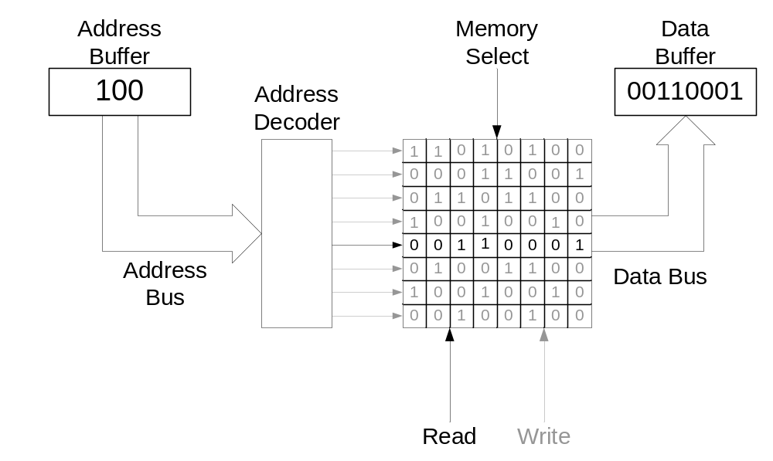
Memory Read Operation

Slide 7
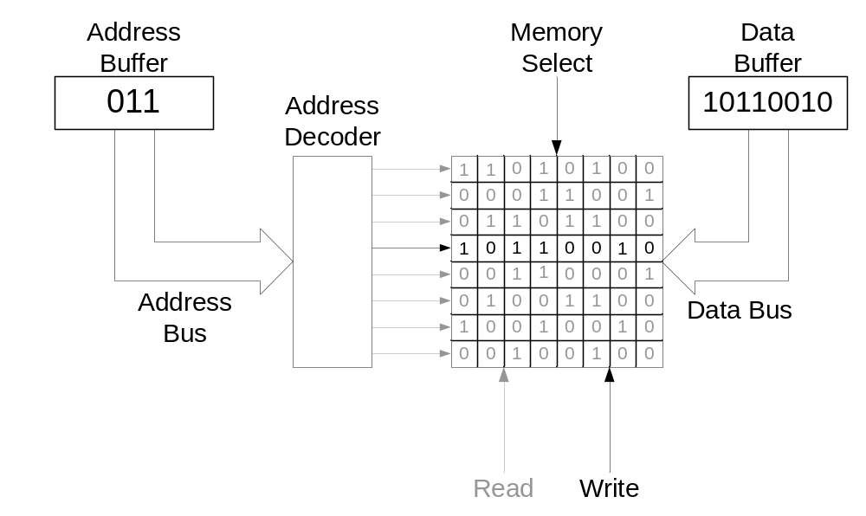
Memory Write Operation

Slide 8
Building Memory in Hierarchy
Design a 1Mx8 using 1Mx4 memory chips
1Mx4
D7
D6
D5
D4
CS
R/W
A19
A19
1Mx4
D3
A18
A18
A17
A17
D2
D1
A0
A0
D0
CS
CS
R/W

Slide 9
Building Memory in Hierarchy
Design a 2Mx4 using 1Mx4 memory chips
A19
1Mx4
D3
Note that 1-to-2
decoder is the wire
itself (or use
an inverter)
A18
A17
D2
D1
D0
A0
CS
R/W
1-to-2
Decoder
A20
1
0
A19
1Mx4
A18
CS
A17
A0
CS
R/W

Slide 10
Building Memory in Hierarchy
Design a 2Mx8 using 1Mx4 memory chips
A19
A19
D7
A18
A18
1Mx4
A17
A17
D6
D5
A0
A0
CS
R/W
D4
1-to-2
Decoder
A19
1Mx4
D3
A20
1
A18
D2
A17
0
D1
A0
CS
R/W
D0
CS
A19
1Mx4
A18
A17
A0
CS
R/W
A19
1Mx4
A18
A17
A0
CS
R/W

Slide 11
Read Only Memory (ROM)
“Permanent” binary information is stored
Non-volatile memory
  Power off does not erase information stored
ROM
K-bit address lines
N-bit Data Output
2^{k} words
N-bit per word
K
N

Slide 12
32x8 ROM
32x8 ROM
5
8
Each represents 32 wires
A4
0
1
A3
2
5-to-32
Decoder
3
A2
A1
28
A0
29
30
31
Fuse can be
implemented as
a diode or a
pass transistor
D7
D6
D5
D4
D3
D2
D1
D0

Slide 13
Programming the 32x8 ROM
A4 | A3 | A2 | A1 | A0 | D7 | D6 | D5 | D4 | D3 | D2 | D1 | D0
0 | 0 | 0 | 0 | 0 | 1 | 1 | 0 | 0 | 0 | 1 | 0 | 1
0 | 0 | 0 | 0 | 1 | 1 | 0 | 0 | 0 | 1 | 0 | 1 | 1
0 | 0 | 0 | 1 | 0 | 1 | 0 | 1 | 1 | 0 | 0 | 0 | 0
… | … | … | … | … | … | … | … | … | … | … | … | …
1 | 1 | 1 | 0 | 1 | 0 | 0 | 0 | 1 | 0 | 0 | 0 | 0
1 | 1 | 1 | 1 | 0 | 0 | 1 | 0 | 1 | 0 | 1 | 1 | 0
1 | 1 | 1 | 1 | 1 | 1 | 1 | 1 | 0 | 0 | 0 | 0 | 1
A4
0
1
A3
2
5-to-32
Decoder
A2
A1
A0
29
30
31
D7
D6
D5
D4
D3
D2
D1
D0

Slide 14
Example: Lookup Table
Design a square lookup table for F(X) = X² using ROM
X | F(X)=X²
0 | 0
1 | 1
2 | 4
3 | 9
4 | 16
5 | 25
6 | 36
7 | 49
X | F(X)=X²
000 | 000000
001 | 000001
010 | 000100
011 | 001001
100 | 010000
101 | 011001
110 | 100100
111 | 110001

Slide 15
Square Lookup Table using ROM
0
X | F(X)=X²
000 | 000000
001 | 000001
010 | 000100
011 | 001001
100 | 010000
101 | 011001
110 | 100100
111 | 110001
1
X2
3-to-8
Decoder
2
X1
3
4
X0
5
6
7
F5
F4
F3
F2
F1
F0

Slide 16
Square Lookup Table using ROM
0
X | F(X)=X²
000 | 000000
001 | 000001
010 | 000100
011 | 001001
100 | 010000
101 | 011001
110 | 100100
111 | 110001
1
X2
3-to-8
Decoder
2
X1
3
4
X0
5
6
7
F5
F4
F3
F2
F1
F0
Not Used
= X0

Slide 17
Square Lookup Table using ROM
0
1
X | F(X)=X²
000 | 000000
001 | 000001
010 | 000100
011 | 001001
100 | 010000
101 | 011001
110 | 100100
111 | 110001
X2
3-to-8
Decoder
2
X1
3
4
X0
5
6
7
F5
F4
F3
F2
F1
F0

